Slide 1
Machine Learning Dimensionality Reduction
Dr. Malak Abdullah
Computer Science Department
Jordan University of Science and Technology

Slide 2
Overview
One of the common problems in machine learning is ‘Overfitting’, where the model remembers all the training data including noise and other unrelated features and predicts higher accuracy on training data and does not generalize well to the new dataset.
Say, you have dataset of 25000 customers, performed shopping during different promotions and you have to predict who all are expected to shop in an upcoming promotion. When you try the model on the original dataset, it predicts the outcome with an accuracy of 92% but when we add some more new data, the model predicts the outcome with an accuracy of 75%. This shows that the model doesn’t generalize well on unseen data.
Note: If a training error is low, but the generalization error is high, it means that your model is overfitting the training data.

Slide 3
How to solve overfitting!
Key reason for overfitting is that the model is too complex relative to the amount and noisiness of the training data.
The model can be simplified by selecting simple algorithms, reducing the number of parameters used or noise in the training data e.g. removes outliers.
In order to reduce complexity by reducing features / dimensions, Dimensionality reduction plays a critical role by projecting the dataset onto a lower-dimensional space.
In another words, dimension reduction is basically a pre-processing step for machine learning to reduce the dimension of the dataset.
It is essential to come up with a good set of feature to train by: – Add / Discard features – Derive new feature space,

Slide 4

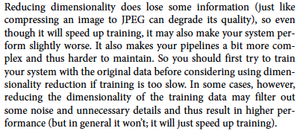
The curse of dimensionality

Slide 5
Feature Engineering; it involves:
1. Feature Selection
It includes creation of subset from the original dataset which includes selecting the most useful feature to train and has lower prediction error than on full model. In this process, some variables are retained or discarded.
2. Feature Extraction
This involves reducing or transforming the data to a lower dimensional space with most relevant information / features.
Common feature extraction methods are:
PCA (Principal Component Analysis)
LDA (Linear Discriminant Analysis)

Slide 6
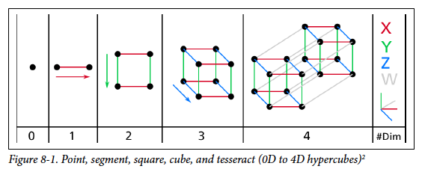
Dimensionality reduction
It reduces the dimensions of a d-dimensional dataset by projecting it onto a (k)-dimensional subspace (where k<d) in order to increase the computational efficiency while retaining most of the information.
Dimensionality reduction implies information loss !!
Transformation
This transformation is defined in such a way that the first principal component has the largest possible variance and each succeeding component in turn has the next highest possible variance.

Slide 7
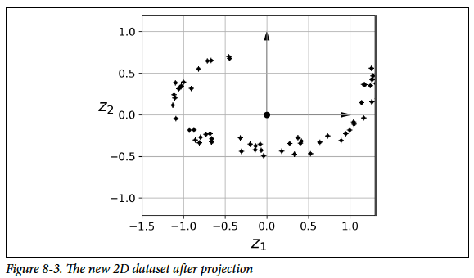
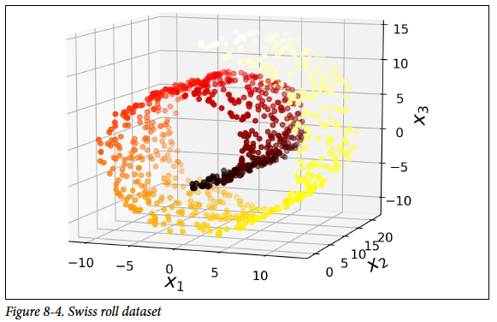
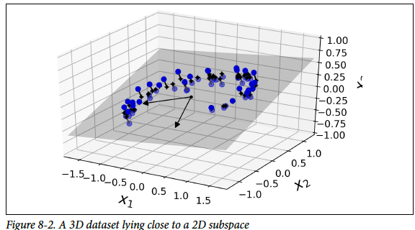
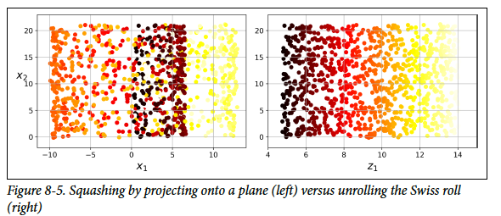
Two Approaches for Dimensionality Reduction
What about this??????
Projection
Manifold Learning

Slide 8
How Does PCA Work?
Principal Component Analysis (PCA) is an unsupervised learning algorithm as it ignores the class labels. We need to find (the so-called principal components) that maximize the variance in a dataset, to find the directions.
To obtain quality/type of coffee, we can use different features of coffee such as its sweetness value, color of coffee, place of coffee and so on, however, many of these features will be redundant or dummy feature variables (can be derived from other features), therefore causing to train model on unnecessary features. In short, we can get the type of coffee with less feature variables and this is what actually PCA does inside the box.
Note that, PCA does not select a set of features and discard other features, but it infers some new features, which best describe the type of class from the existing features.
First it identifies the hyperplane that lies closest to the data, and then it projects the data onto it.
In other words, PCA is basically the summarization of data.

Slide 9
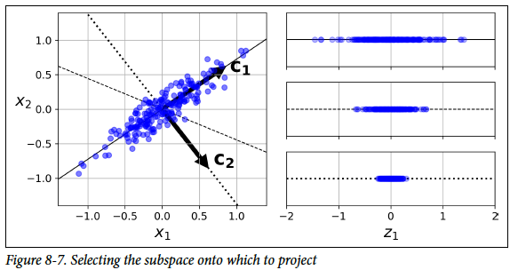
How Does PCA Work?
On the right is the result of the projection of the dataset onto each of these axes. As you can see, the projection onto the solid line preserves the maximum variance, while the projection onto the dotted line preserves very little variance, and the projection onto the dashed line preserves an intermediate amount of variance.
It seems reasonable to select the axis that preserves the maximum amount of variance, as it will most likely lose less information than the other projections.

Slide 10
what the word ‘variance’ has to do with PCA?
Imagine that you land up with a set of features that are unable to distinguish the types of coffee, therefore, these set of features are useless. This type of dimensionality reduction will deteriorate your model accuracy and, in cases will lead to under-fitting of data.
Therefore, PCA looks for properties that show as much variation across datasets as possible.
Now imagine that we compose a square matrix of numbers that describe the variance of the data, and the covariance among variables. This is the covariance matrix. It is an empirical description of data we observe.
PCA works on eigenvectors and eigenvalues of the covariance matrix, which is the equivalent of fitting those straight, principal-component lines to the variance of the data. Why? Because eigenvectors trace the principal lines of force, In other words, PCA determines the lines of variance in the dataset which are called as principal components with the first principal component having the maximum variance, second principal component having second maximum variance and so on.

Slide 11
Let’s Perform the PCA and analyze the graph:
1. Loading the dataset to the memory and performing feature extraction. 2. Scaling the dataset – Can use min-max normalization for scaling the dataset with mean zero and a unit standard deviation. 3. Apply PCA with inbuilt PCA function in sklearn:
from sklearn.decomposition import PCA pca = PCA (n_components=2) X_feature_reduced = pca.fit(X).transform(X)
Here, ‘X’ is the training dataset and ‘n_component’ is the number of PCA components we want to derive from our existing feature set.
So using the sklearn, PCA is like a black box (black box working explained above), you give scaled feature set as an input to sklearn PCA and get PCA components as output which can be used as an input to data training algorithms.

Slide 12
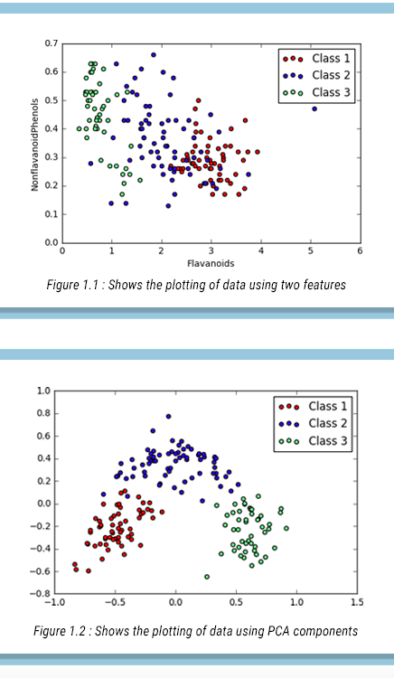
The graph above shows the plotting of data points using two features vs. Plotting of data points using principal components (which is basically summarization of all the features in our dataset)

Slide 13
How Does LDA Work?
Linear Discriminant Analysis is a supervised algorithm as it takes the class label into consideration. It is a way to reduce ‘dimensionality’ while at the same time preserving as much of the class discrimination information as possible.
LDA helps you find the boundaries around clusters of classes.
It projects your data points on a line so that your clusters are as separated as possible, with each cluster having a relative (close) distance to a centroid.
LDA finds a centroid of each class datapoints. For example with thirteen different features LDA will find the centroid of each of its class using the thirteen different feature dataset. Now on the basis of this, it determines a new dimension which is nothing but an axis which should satisfy two criteria: 1. Maximize the distance between the centroid of each class. 2. Minimize the variation (which LDA calls scatter and is represented by s2), within each category.

Slide 14
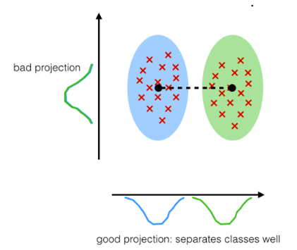
Therefore the gist is:
(meana – meanb)/(Sa – Sb) = ideally large/ideally small
Note: Here ‘mean’ is the centroid of the class. Variation is the spread of data over the plane.
So, if the variation of data is minimum, then less overlapping between the classes will be there and maximum separation will be maintained between the different classes.
So whichever co-ordinate of the new axis satisfies these two criteria, they form the new dimension of dataset.

Slide 15
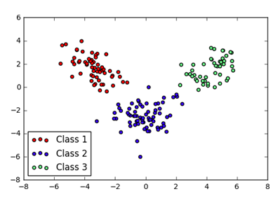
Let’s perform the LDA and analyse the graph:
1. Loading the dataset to the memory and performing feature extraction. 2. Scaling the dataset – Can use min-max normalization for scaling the dataset with mean zero and a unit standard deviation. 3. Apply LDA with inbuilt LDA function in sklearn
from sklearn.decomposition import LDA lda = LDA(n_components=2) X_feature_reduced = lda.fit(X).transform(X)
the graph of two LDA components (LDA1 and LDA2) obtained by applying LDA (plotted using matplotlib scatterplot)
Maximize the between class measure & minimize the within class measure.

Slide 16
In the graph, you can visualize the whole dataset properly differentiate well among the classes. This is the major difference between PCA and LDA.
To conclude, PCA performs better in case where number of samples per class is less. Whereas LDA works better with large dataset having multiple classes; class separability is an important factor while reducing dimensionality.
Ref:
http://www.vfirst.com/blog/techfirst/dimension-reduction-techniques-pca-vs-lda-in-machine-learning-part-2/

Slide 17
Machine Learning Ch 9 from the new book Unsupervised Learning Techniques
Dr. Malak Abdullah
Computer Science Department
Jordan University of Science and Technology

Slide 18
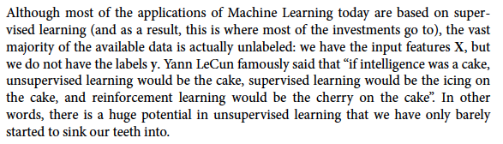
Unsupervised learning
the icing on the cake definition: 1. something that makes a good situation even better: 2. an unexpected additional good thing

Slide 19
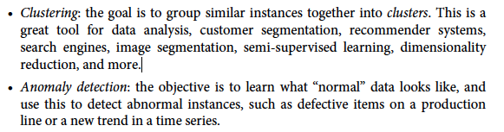
unsupervised learning tasks and algorithms:

Slide 20
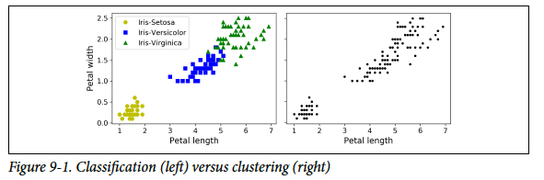
Clustering
It is the task of identifying similar instances and assigning them to clusters, i.e., groups of similar instances.
It is useful for customer segmentation: you can cluster your customers based on their purchases, their activity on your website, and so on. This is useful to understand who your customers are and what they need, so you can adapt your products and marketing campaigns to each segment. For example, this can be useful in recommender systems to suggest content that other users in the same cluster enjoyed.
It is also useful for data analysis: when analyzing a new dataset, it is often useful to first discover clusters of similar instances, as it is often easier to analyze clusters separately.
For semi-supervised learning: if you only
have a few labels, you could perform
clustering and propagate the labels to all
the instances in the same cluster.

Slide 21
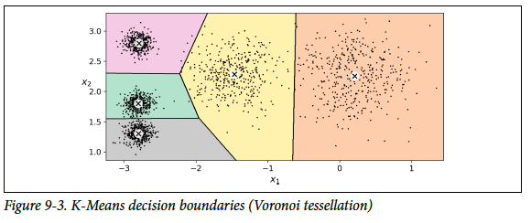
Clustering Algorithm
There is no universal definition of what a cluster is: it really depends on the context, and different algorithms will capture different kinds of clusters. For example, some algorithms look for instances centered around a particular point, called a centroid. Others look for continuous regions of densely packed instances: these clusters can take on any shape. Some algorithms are hierarchical, looking for clusters of clusters. And the list goes on.
In this class we will look at clustering algorithms K-Means

Slide 22
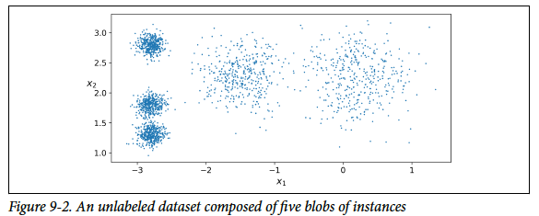
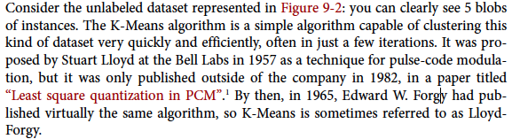
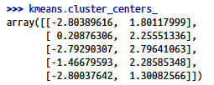

K-Means

Slide 23
Soft Clustering
Instead of assigning each instance to a single cluster, which is called hard clustering, it can be useful to just give each instance a score per cluster: this is called soft clustering.

Slide 24
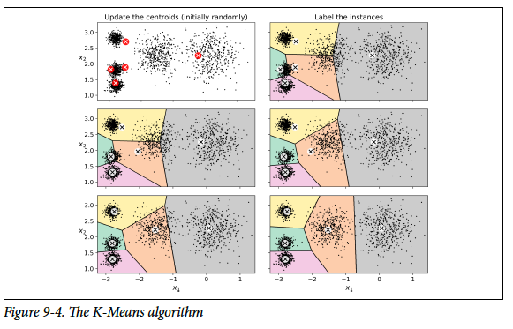
How Clustering works?
start by placing the centroids randomly (e.g., by picking k instances at random and using their locations as centroids). Then label the instances, update the centroids, label the instances, update the centroids, and so on until the centroids stop moving. The algorithm is guaranteed to converge in a finite number of steps (usually quite small), it will not oscillate forever2. You can see the algorithm in action in Figure 9-4

Slide 25
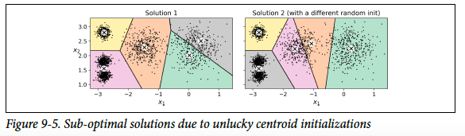
Not the right solution
Unfortunately, although the algorithm is guaranteed to converge, it may not converge to the right solution (i.e., it may converge to a local optimum): this depends on the centroid initialization. For example, Figure 9-5 shows two sub-optimal solutions that the algorithm can converge to if you are not lucky with the random initialization step
So we need Centroid Initialization Methods

Slide 26
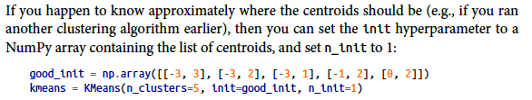

Centroid Initialization Methods
But how exactly does it know which solution is the best? Well of course it uses a performance metric! It is called the model’s inertia: this is the mean squared distance between each instance and its closest centroid.
It is roughly equal to 223.3 for the model on the left of Figure 9-5, 237.5 for the model on the right of Figure 9-5, and
211.6 for the model in Figure 9-3. The Kmeans class runs the algorithm n_init times and keeps the model with the lowest inertia: in this example, the model in Figure 9-3 will be selected

Slide 27
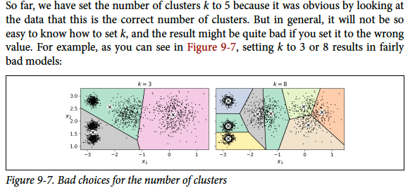
Finding the Optimal Number of Clusters

Slide 28
How to choose the number of clusters
You might be thinking that we could just pick the model with the lowest inertia, right?
Unfortunately, it is not that simple. The more clusters there are, the closer each instance will be to its closest centroid, and therefore the lower the inertia will be.
use the silhouette score, which is the mean silhouette coefficient over all the instances. An instance’s silhouette coefficient is equal to (b – a) / max(a, b) where a is the mean distance to the other instances in the same cluster (it is the mean intra-cluster distance), and b is the mean nearest-cluster distance, that is the mean distance to the instances of the next closest cluster (defined as the one that minimizes b, excluding the instance’s own cluster). The silhouette coefficient can vary between -1 and +1: a coefficient close to +1 means that the instance is well inside its own cluster and far from other clusters, while a coefficient close to 0 means that it is close to a cluster boundary, and finally a coefficient close to -1 means that the instance may have been assigned to the wrong cluster. To compute the silhouette score, you can use Scikit-Learn’s silhouette_score() function, giving it all the instances in the dataset, and the labels they were assigned:

Slide 29
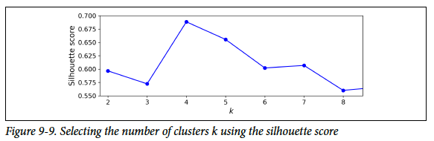
Using Silhouette score
As you can see, this visualization is much richer than the previous one: in particular, although it confirms that k=4 is a very good choice, it also underlines the fact that k=5 is quite good as well, and much better than k=6 or 7. This was not visible when comparing inertias.

Slide 30
Limits of K-Means
Despite its many merits, most notably being fast and scalable, K-Means is not perfect.
As we saw, it is necessary to run the algorithm several times to avoid sub-optimal solutions,
plus you need to specify the number of clusters, which can be quite a hassle.
Moreover, K-Means does not behave very well when the clusters have varying sizes, different densities, or non-spherical shapes.
Note: It is important to scale the input features before you run K-Means, or else the clusters may be very stretched, and K-Means will perform poorly. Scaling the features does not guarantee that all the clusters will be nice and spherical, but it generally improves things.

Slide 31
Using clustering for image segmentation
Image segmentation is the task of partitioning an image into multiple segments.
In semantic segmentation, all pixels that are part of the same object type get assigned to the same segment.
For example, in a self-driving car’s vision system, all pixels that are part of a pedestrian’s image might be assigned to the “pedestrian” segment (there would just be one segment containing all the pedestrians).
In instance segmentation, all pixels that are part of the same individual object are assigned to the same segment. In this case there would be a different segment for each pedestrian. The state of the art in semantic or instance segmentation today is achieved using complex architectures based on convolutional neural networks (talk about this later).
Here, we are going to do something much simpler: color segmentation. We will simply assign pixels to the same segment if they have a similar color.

Slide 32


How it works?
The image is represented as a 3D array: the first dimension’s size is the height, the second is the width, and the third is the number of color channels, in this case red, green and blue (RGB).
In other words, for each pixel there is a 3D vector containing the intensities of red, green and blue, each between 0.0 and 1.0 (or between 0 and 255 if you use imageio.imread()).
Some images may have less channels, such as grayscale images (one channel), or more channels!
The following code reshapes the array to get a long list of RGB colors, then it clusters these colors using K-Means. For example, it may identify a color cluster for all shades of green. For example, all shades of green may be replaced with the same light green color (assuming the mean color of the green cluster is light green). Finally it reshapes this long list of colors to get the same shape as the original image. And we’re done!

Slide 33
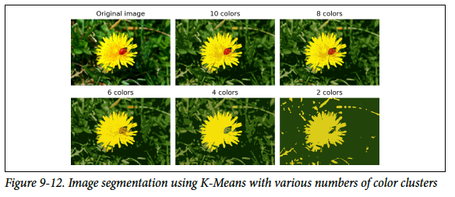

Slide 34
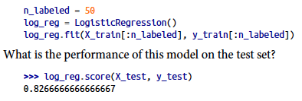

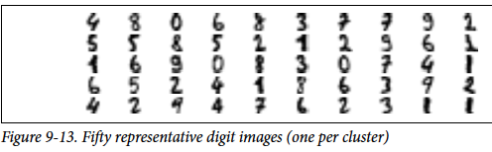
Using Clustering for Semi-Supervised Learning
Another use case for clustering is in semi-supervised learning, when we have plenty of unlabeled instances and very few labeled instances. Let’s train a logistic regression model on a sample of 50 labeled instances from the digits dataset:
First, let’s cluster the training set into 50 clusters, then for each cluster let’s find the image closest to the centroid. We will call these images the representative images:

Slide 35


Continue…
Now let’s look at each image and manually label it:
y_representative_digits = np.array([4, 8, 0, 6, 8, 3, ..., 7, 6, 2, 3, 1, 1])
Now we have a dataset with just 50 labeled instances, but instead of being completely random instances, each of them is a representative image of its cluster.
But perhaps we can go one step further: what if we propagated the labels to all the other instances in the same cluster? This is called label propagation:
We got a tiny little accuracy boost. Better than nothing, but not astounding. The problem is that we propagated each representative instance’s label to all the instances in the same cluster, including the instances located close to the cluster boundaries, which are more likely to be mislabeled. Let’s see what happens if we only propagate the labels to the 20% of the instances that are closest to the centroids:

Slide 36
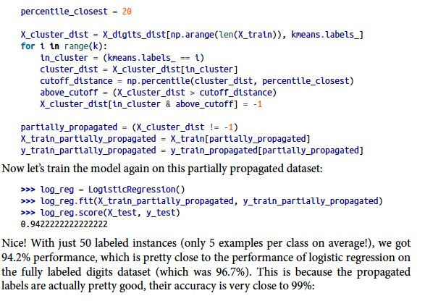
Continue

Slide 37
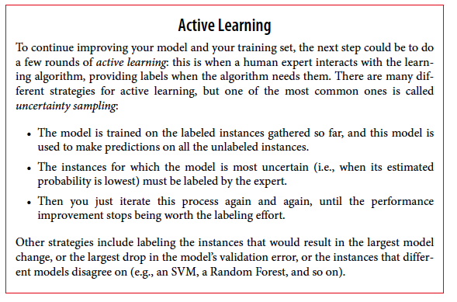

Slide 38
The end ☺

